Slide 1
Sorting Algorithms Lecture 8

Slide 2
Sorting by Exchange: Quick Sort
Divide-and-Conquer

Slide 3
QUICK SORT (Basic Ideas)
(Another divide-and-conquer algorithm)
Pick an element, say P (the pivot)
Re-arrange the elements into 3 sub-blocks,
Those less than or equal to (<=) P (the left-block S1)
P (the only element ¡n the middle-block)
Those greater than or equal to (>=) P (the right-block S2)
Repeat the process recursively for the left- and right- sub-blocks Return (quicksort(S1), P,quicksort(S2)}.
That is the results of quicksort(S1), followed by P, followed by the results of quicksort(S2)

Slide 4
QUICK SORT (Basic Ideas)
The main idea is to find the “right” position for the pivot element P
After each “pass”, the pivot element, P, should be “in place”
Eventually, the elements are sorted since each pass puts at least one element (i.e., P) into its final position

Slide 5
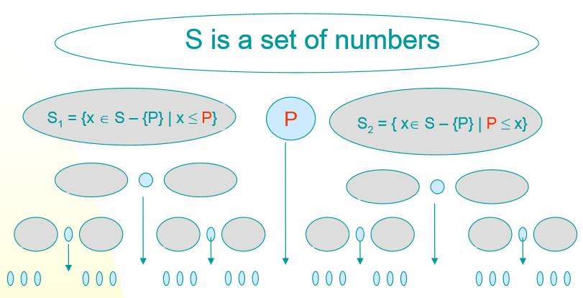
QUICK SORT (Basic Ideas)

Slide 6
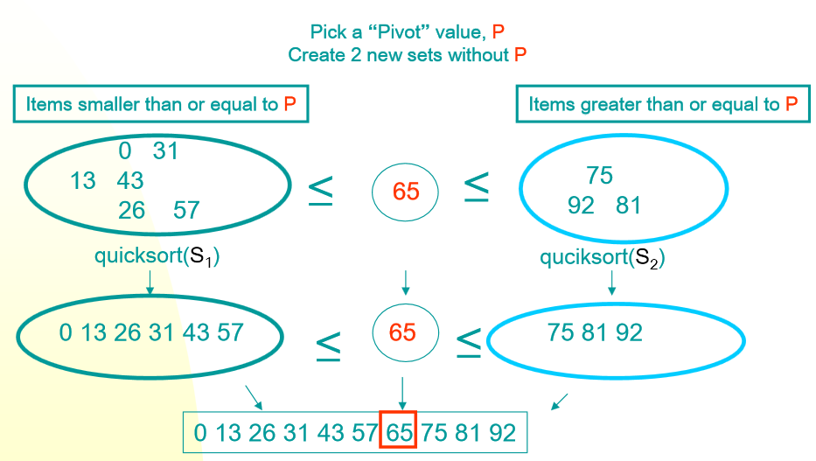
QUICK SORT (Basic Ideas)

Slide 7
Randomized
Quick
Sort
52471326
LT
GT
EQ
5241326
NULL
NULL
LT
EQ
GT
2132
NULL
56
Divide
LT
EQ
GT
LT
EQ
GT
NULL
NULL
232
NULL
NULL
6
LT
EQ
GT
NULL
2
3
6

Slide 8
Randomized
Quick
Sort
7
LT
GT
EQ
4
NULL
NULL
LT
EQ
GT
1
NULL
5
Divide
LT
EQ
GT
LT
EQ
GT
NULL
NULL
2
NULL
NULL
6
LT
EQ
GT
NULL
2
3
7

Slide 9
Randomized
Quick
Sort
7
LT
GT
EQ
4
NULL
NULL
LT
EQ
GT
1
NULL
5
Combine
LT
EQ
GT
LT
EQ
GT
NULL
NULL
223
NULL
NULL
6
8

Slide 10
Randomized
Quick
Sort
7
LT
GT
EQ
4
NULL
NULL
LT
EQ
GT
1223
NULL
56
Combine
9

Slide 11
Randomized
Quick
Sort
7
LT
GT
EQ
1223456
NULL
NULL
Combine
10

Slide 12
Randomized
Quick
Sort
12234567
Combine
11

Slide 13
Randomized Quick Sort
•
The
worst-case
running
time
for
randomized
quick-sort is O(n^2)
•
The
worst
case
happens
if
the
sizes
of
the
subproblems are
not balanced.
•
The
selection
of
the
pivot
element
determines
the sizes of the subproblems. It is thus crucial to
select a `good' pivot.
•
If
the
sizes
of
the
subproblems
is
balanced,
worst-case
running
time
for
randomized
quick-
12
sort is bounded by O(nlog2 n)

Slide 14
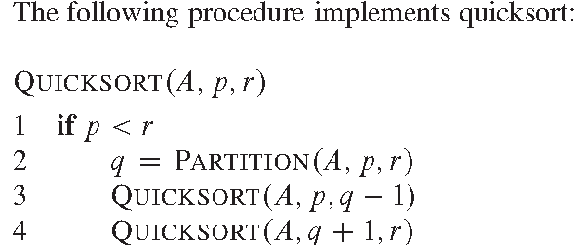
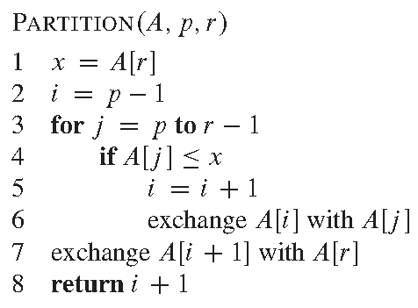
Inline
Quick
Sort
13

Slide 15
Inline Quick Sort
•
•
•
Sorting A[7 1
p = 0, r = 3
p < r
5
3]
–
Partition ( A, 0, 3)
•
•
•
x = A[r] = 3
i = p – 1 = -1 j =0
–
–
j = 1
–
–
A[j] <= x
7 <= 3
•
A[j] <= x
1 <= 3
» i = i + 1 => i = 0
» After swap of A[i] with A[j], i.e., A[0] with A[1]
• A [ 1 7 5 3]
•
j = 2
–
–
A[j] <= x
5 <= 3
14

Slide 16
Inline Quick Sort
•
•
•
Sorting A[1 7
p = 0, r = 3
p < r
5
3]
–
Partition ( A, 0, 3)
•
•
•
x = A[r] = 3
i = 0
After swap of A[i + 1] with A[r], i.e., A[1] with A[3]
• A [ 1 3 5 7]
return i + 1 => i = 1
1
•
q =
–
–
–
Quicksort(A, p, q-1) => (A, 0, 0) <- This function will return on p<r
Quicksort(A, q+1, r) => (A, 2, 3)
15

Slide 17
Inline Quick Sort
•
•
•
Sorting A[1 3 5
p = 2, r = 3
p < r
7]
–
Partition ( A, 2, 3)
•
•
•
x = A[r] = 7
i = p – 1 = 2 – 1 = 1
j =2
– A[j] <= x
– 3 <= 7
» i = i + 1 => i = 2
» After swap of A[i] with A[j], i.e., A[2] with A[2]
• A [ 1 3 5 7]
After swap of A[i + 1] with A[r], i.e., A[3] with A[3]
• A [ 1 3 5 7]
return i + 1 => i = 3
3
•
•
q =
–
16

Slide 18
Inline Quick Sort
•
•
•
Sorting A[1 3 5
p = 2, r = 3
p < r
7]
–
–
–
–
Partition ( A, 2, 3)
q = 3
Quicksort(A, p, q-1) => (A, 2, 2) <- This function will return on p<r
Quicksort(A, q+1, r) => (A, 4, 3) <- This function will return on p<r
17

Slide 19
QUICK SORT

Slide 20
QUICK SORT (Example 2)

Slide 21
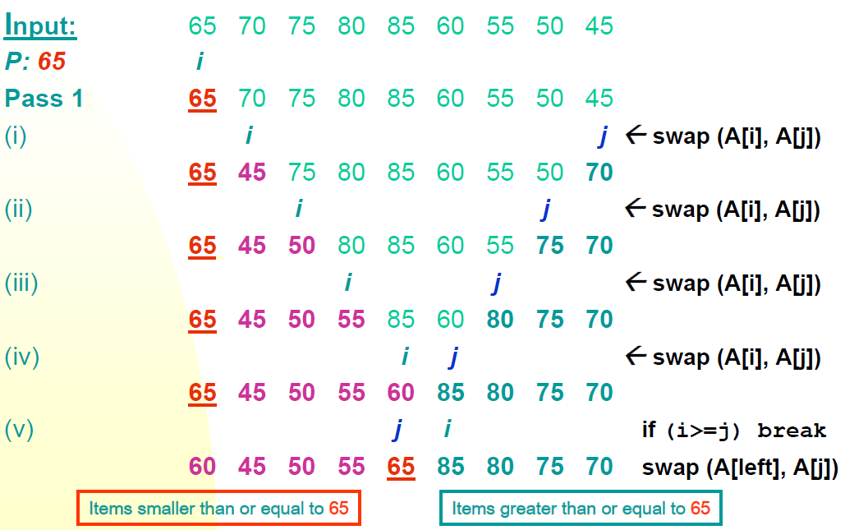
Example 3

Slide 22
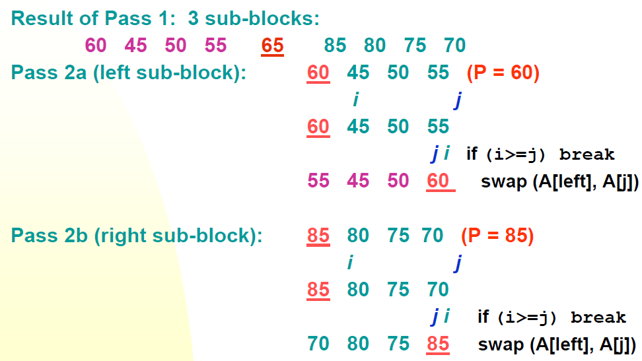
Example 3

Slide 23
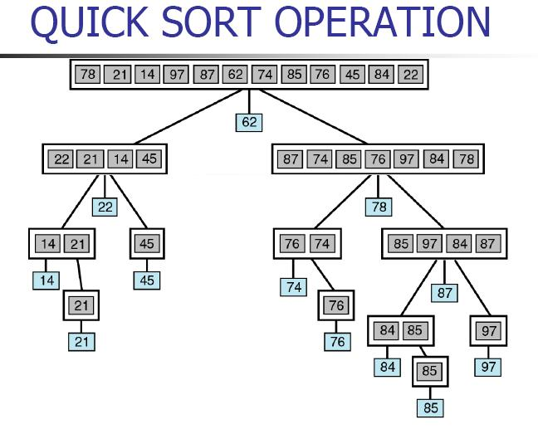
Example 4

Slide 24
ALGORITHM
Let A be a linear array of n elements A (1), A (2), A (3)......A (n), low represents the lower bound pointer and up represents the upper bound pointer. Key represents the first element of the array, which is going to become the middle element of the sub-arrays.
1. Input n number of elements in an array A
2. Initialize low = 0, up = n , key = A[(low + up)/2]
3. Repeat through step 8 while (low < = up)
4. Repeat step 5 while(A [low] > key)
5. low = low + 1
6. Repeat step 7 while(A [up] < key)
7. up = up–1
8. If (low < = up)
(a) Swap = A [low]
(b) A [low] = A [up]
(c) A [up] = swap
(d) low=low+1
(e) up=up–1
9. If (1 < up) Quick sort (A, 1, up)
10. If (low < n) Quick sort (A, low, n)
11. Exit

Slide 25
QUICK SORT (Program)
int partition(int arr[], int left, int right)
{
int i = left, j = right;
int tmp;
int pivot = arr[(left + right) / 2];
while (i <= j) {
while (arr[i] < pivot)
i++;
while (arr[j] > pivot)
j--;
if (i <= j) {
tmp = arr[i];
arr[i] = arr[j];
arr[j] = tmp;
i++;
j--;
}
};
return i;
}

Slide 26
QUICK SORT (Program)
void quickSort (int arr[], int left, int right) {
int index = partition(arr, left, right);
if (left < index - 1)
quickSort(arr, left, index - 1);
if (index < right)
quickSort(arr, index, right);
}

Slide 27
Picking the Pivot
A “good” pivot is one that creates two even sized partitions
Median will be best, but finding median could be as tough as sorting itself
How about choosing the first element?
What if array already or nearly sorted?
Good for a randomly populated array
How about choosing a random element?
Good in practice if “truly random”
Still possible to get some bad choices
Requires execution of random number generator

Slide 28
Picking the Pivot
Best choice of pivot
Median of array
But median is expensive to calculate
Next strategy: Approximate the median
Estimate median as the median of any three elements
Median = median {first, middle, last}
Has been shown to reduce
running time (comparisons) by 14%
8 1 4 9 0 3 5 2 7 6
will result in
1 0 3 2 4 8 9 5 7 6
pivot
8 1 4 9 0 3 5 2 7 6
will result in
1 4 0 3 5 2 6 8 9 7

Slide 29
Running time analysis
The advantage of this quick sort is that we can sort “in-place”, i.e., without the need for a temporary buffer depending on the size of the inputs.(merge sort)
Partitioning Step: Time Complexity is θ(n)
Recall that quick sort involves partitioning, and 2 recursive calls
Thus, giving the basic quick sort relation:
T(n) = θ(n)+ T(i) + T(n-i-1) = cn+ T(i) + T(n-i-1)
where I is the size of the first sub-block after partitioning
We shall take T(0) = T(1) = 1 as the initial conditions

Slide 30
Running time analysis
Worst-Case (Data is sorted already)
When the pivot is the smallest (or largest) element at partitioning on a block of size n, the result
yields one empty sub-block, one element (pivot) in the “correct” place and one sub-block of size (n-1)
takes θ(n) times
Recurrence Equation:
T(1) = 1
T(n) = T(n-1) + cn
Solution: θ(n2)
Worse than Mergesort!!!

Slide 31
Running time analysis
Best case:
The pivot is in the middle (median) (at each partition step), i.e. after each partitioning, on a block of size n, the result
yields two sub-blocks of approximately equal size and the pivot element in the “middle” position
takes n data comparisons
Recurrence Equation becomes
T(1) = 1
T(n) = 2T(n/2) + cn
Solution: θ(n logn)
Comparable to Merge sort!!

Slide 32
So the trick is to select a good pivot
Different ways to select a good pivot
First element
Last element
Median-of-three elements
Pick three elements, and find the median x of these elements. Use that median as the pivot
Random element
Randomly pick a element as a pivot

Slide 33
Sources used
Lectures by Mr. Mohammad Asad Abbasi

